Slide 1
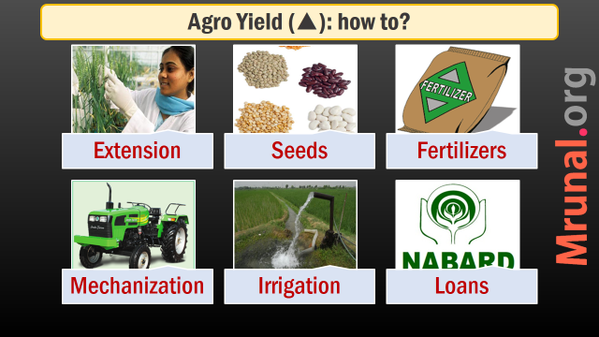
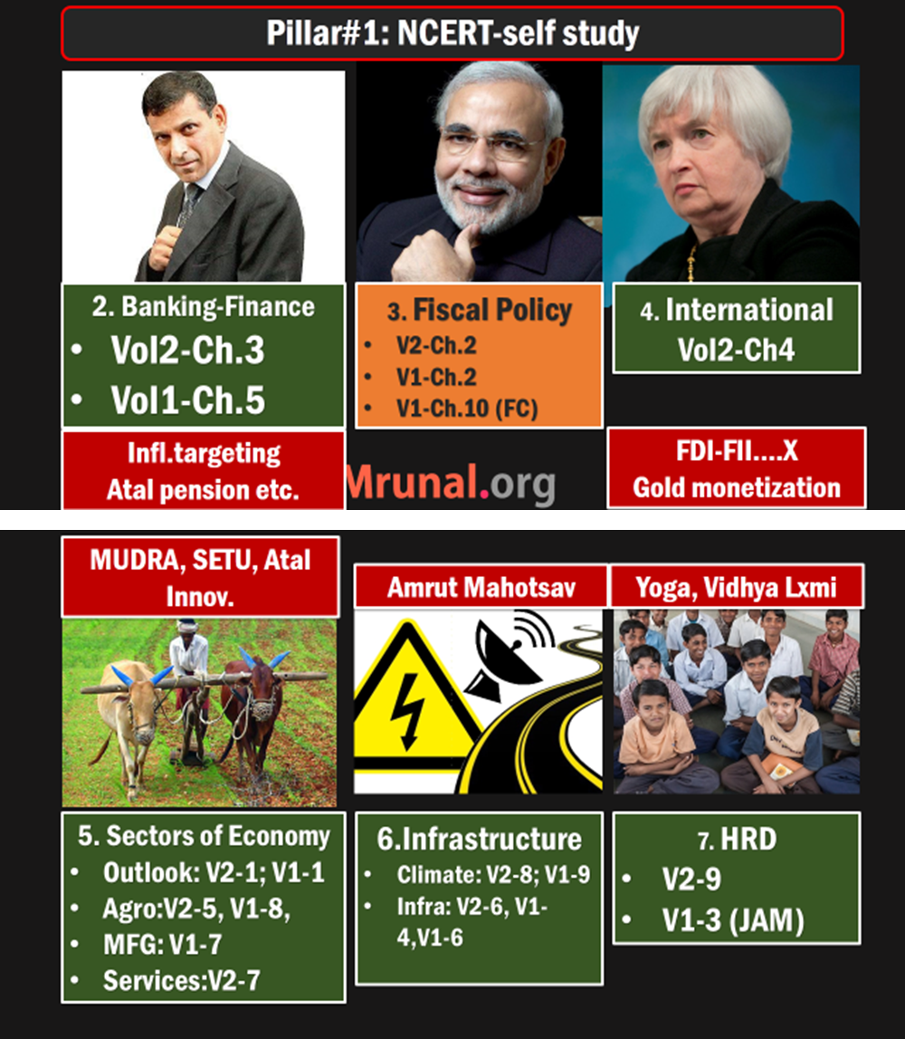
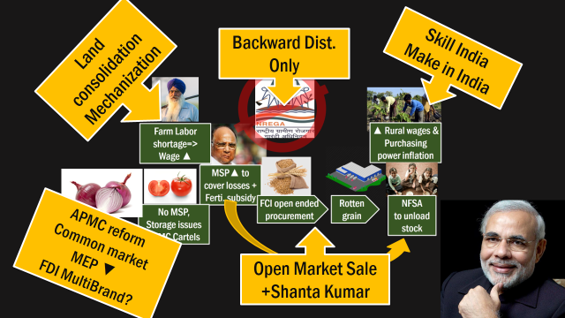
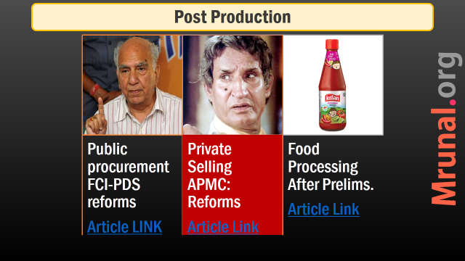

Slide 2
Sectors of Economy: Mfg, Service Industries
Industrial Policy
MSME
Corporates
Make in India
Skill India
Survey

Slide 3
Industrial Policy
1948 | Shyama Prasad Mukerjee: 1st industrial policy.
1956 | policy revised- main focus on PSU
1991 | LPG reforms, Narsimharao’s new industrial policy.

Slide 4
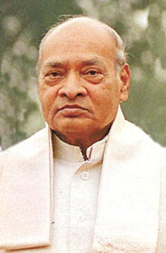
industrial policy features
1991
FDI relaxed
NRI can invest upto 100%
Software technology parks
Disinvestment of PSU, Miniratna-Navratna
MRTP act (‘69)=> CCI act (2002)

Slide 5
3 sector reserved for public sector
Atomic Energy
Atomic Minerals
Rail Transport
Public Sector only

Slide 6
Industrial License required for…
Alcohol distillation Brewing
Tobacco Cigar
Electronic Aerospace & Defense
Industrial Explosives
Safety fuse, matches, nitrocellulose
Hazardous Chemical
License given by Secretarial of Industrial Assistance (SIA) under DIPP
Others just file Industrial Entrepreneur’s Memorandum (IEM) @DIPP
Notes:
Department of Industrial Policy & Promotion (DIPP),

Slide 7

Hazardous Chemicals
License
HCN: Hydrocyanic acid= Prussic acid. Dye, explosive, pesticides
Phosgene: plastic, pesticides
Carbon’s Isocyanates. E.g. Methyl Isocyanate (MIC) Union Carbide-fertilizers/pesticides (Sevin), Bhopal tragedy 3/12/84

Slide 8
Policies
Industrial
1991
MFG
2011
IT policy
2012
Telecom
2012
(INFRA Ch.)
FDI Policy (BoP Ch.)

Slide 9
Manufacturing Policy 2011
MFG’s Share in GDP
Raise from 15% to 25%
Job & Skilling
100 million jobs in a decade
Labor inventive Textile, IT, MSME
Start up cos: tax benefits
CSO New method: 32%
Skilling: Skill India, Din Dayal Antyodaya, NSDC etc.
Focus
Infra
Finance via PPP =>REITS, INVITS
NIMZ, Industrial corridors, mfg. promotion boards
Budget 2015: Royalty 10%

Slide 10
IT Policy 2012
E-Literacy
1 E-literate in Each household
Jobs
1 crore new IT personnel
E-governance
Software/portals
Cybercrime
Strong framework
Modi’s Digital India mission, NOFN=> rural broadband
Vernacular
PH friendly
CERT-IN
E-Kranti system
Notes:
Computer Emergency Response Teams (CERTs)

Slide 11
Policies
Industrial
1991
MFG
2011
IT policy
2012
Telecom
2012
(INFRA Ch.)
FDI Policy (BoP Ch.)

Slide 12
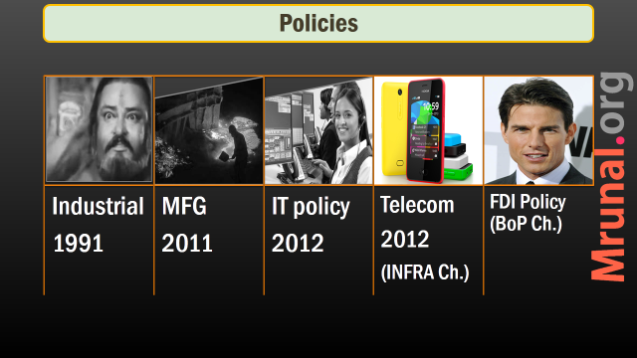


Slide 13
Small industries
Cottage
MSME
SSI
Village industry
Organized Unorg.

Slide 14
Cottage
Village industry
Family members
No hired
Capital investment negligible
Handmade products
Area <10k population
Investment<15k / worker

Slide 15

Organized Sector
17% of units
Social security, EPF, Maternity benefit available.
Factories Act, 1948 [10 workers, with power = “registered units”]
Shops and Commercial Establishments Acts of State Governments
Industrial Employment Standing Orders Act, 1946 etc
Plantation acts, bidi-cigar
PSUs, Cooperatives

Slide 16
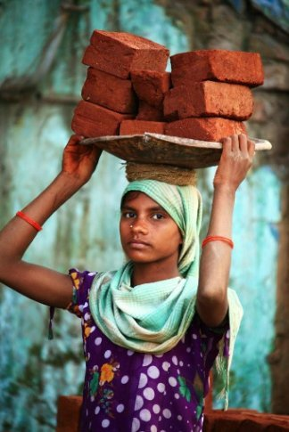
Unorganized sector
83% units
Not covered under organized sector.
But no consensus over definition, esp. for service sector.
Unorganized Workers Social Security Act 2008
Social security boards setup at national and state levels.
Social security, fin.inclusion => in HRD ppt later.

Slide 17
Small industries
Cottage
MSME
SSI
Village industry
Organized Unorg.

Slide 18
MSME Classification: investment
 | Mfg. Sector (32%)
MICRO | upto 25 lakhs
SMALL | >25 lakhs
MED. | >5 cr. Upper limit 10 cr.

Slide 19
MSME Classification: investment
 | Mfg. Sector (32%) | Service (68%)
MICRO | upto 25 lakhs | upto 10 lakhs
SMALL | >25 lakhs | >10
MED. | >5 cr. Upper limit 10 cr. | >2 cr. upper limit 5 cr.

Slide 20
Small industries
Cottage
MSME
SSI
Village industry
Organized Unorg.

Slide 21
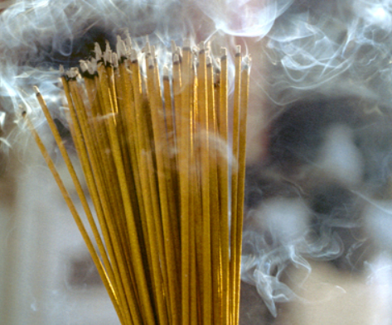
Investment up to 1 crore (varies by item)
SSI
Pickles & chutneys Bread two edible oils (without solvent extraction) -Mustard oil, Ground nut oil Wooden furniture and fixtures Exercise books and registers Wax candles Laundry soap | Safety matches Fire works Agarbatties Glass bangles Steel almirah Rolling shutters Steel chairs, tables, furniture Padlocks utensils- stainless steel, aluminum
Notes:
'; At present, a small scale industrial unit is an undertaking in which investment in plant and machinery, does not exceed Rs.1crore, except in respect of certain specified items under hosiery, hand tools, drugs and pharmaceuticals, stationery items and sports goods, where this investment limit has been enhanced to Rs.5 crore. A comprehensive legislation which would enable the paradigm shift from small scale industry to small and medium enterprises is under consideration of Parliament. Pending enactment of the above legislation, current SSI/ tiny industries definition may continue. Units with investment in plant and machinery in excess of SSI limit and up to Rs. 10 crore may be treated as Medium Enterprises (ME).';

Slide 22
Items reserved
SSI
Non-MSME industry (=large industry) must get license + 50% export
Doesn’t apply to SEZ

Slide 23
License required for…
Alcohol distillation Brewing
Tobacco Cigar
Electronic Aerospace & Defense
Industrial Explosive
Large industry in SSI products
Hazardous Chemical
License given by Secretarial of Industrial Assistance (SIA) under DIPP
Others just file Industrial Entrepreneur’s Memorandum (IEM) @DIPP
Notes:
Department of Industrial Policy & Promotion (DIPP),

Slide 24
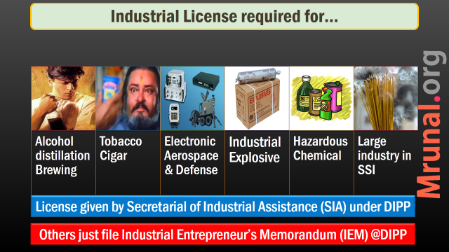



Slide 25
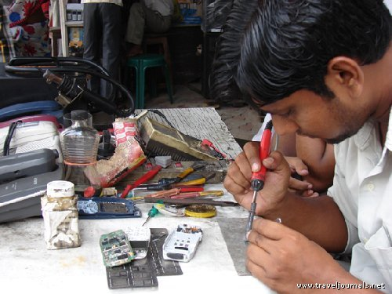
Tax Benefits
MSME
No excise duty: 1.5 cr turnover
No Service tax: <10 lakh /year
Capital subsidy: 15 lakhs to purchase.
SEDF / SIDBI
Khadi board, Coir Board, Udhyami mitra Yojana etc.
Budget 2015: MUDRA BANK, AIM, SETU

Slide 26

Why Mudra Bank?
MSME
Total >5.5 crore units
40% export contribution
62% owned by SC/ST/OBC
Need small loans: 50k-10L
Only 4% can get through formal lenders (Bankers, NBFC, MicroFin)
Need addl. 80 Billion$ credit supply

Slide 27



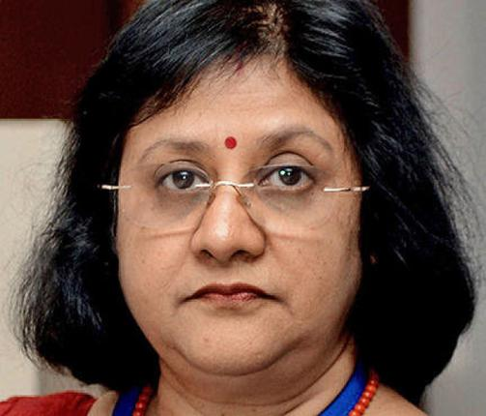
MFIs can’t accept Demand Deposits (CASA)
Borrow from
Banks, NBFCs @14%
Loan to SHG, MSME
@24%
MUDRA bank regulate and refinance MFIs
For MSME

Slide 28
Mudra Bank Features
MSME
1990: Bangladesh Palli Karma-Sahayak Foundation (PKSF).
Announced in Budget 2015
Initially, a subsidiary of SIDBI
Later Act => full fledge institution
Bank….X
Regulator and Refinancer
OF MFIs serving MSME

Slide 29
Mudra Bank Functions
MSME
MFI: register, regulate, refinance, rating
Client protection in loan recovery
Last mile delivery of credit + technology
Pradhan Mantri Mudra Yojana
Credit guarantee scheme for micro enterprises

Slide 30
PSL: What if targets not met?
Desi (+Foreign 20) | Foreign bank <20
Remaining $$ to RIDF | To SEDF
Rural infra. Development fund | small enterprises development fund
NABARD manages | SIDBI manages
NABARD pays interest to bank | Same by SIDBI
State governments get infra. Loan | Similar case: state industrial fin.corp.
RBI will pull out 20,000 Crores
& give to MUDRA Bank

Slide 31
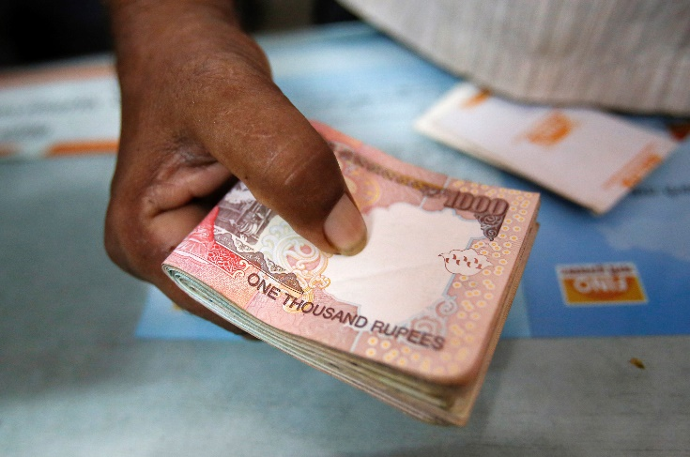
Money from where?
Mudra
RBI: 20k Cr. from PSL shortfalls. Will be Used for refinancing the MFIs for small industries
Government: 3k cr. Credit guarantee to Micro enterprises.

Slide 32
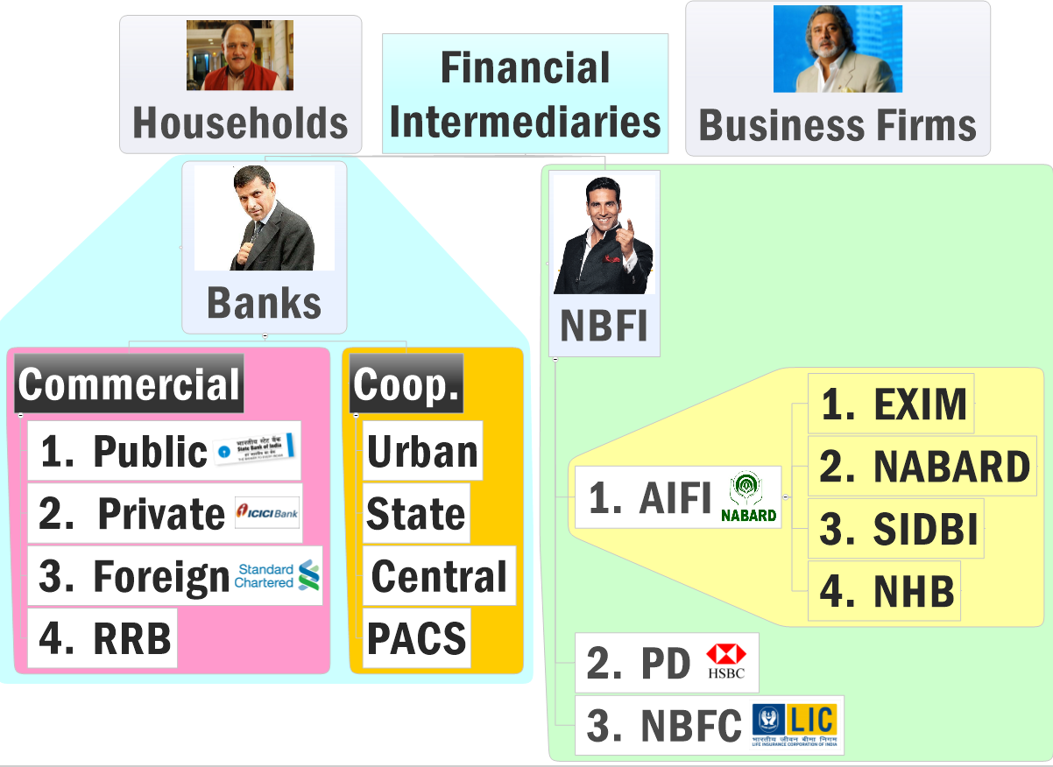
Criticism
MUDRA
Duplication of Efforts vs. AIFI
Why not reform SIDBI?
+ RBI proposed “Small Banks”

Slide 33
Budget 2015 for small industries
MUDRA
ATAL
SETU

Slide 34

Atal innovation mission
Budget 2015
Atal Innovation Mission (AIM)
Under NITI ayog with Rs.150 crores.
Innovation using experts and academicians, R&D hubs.

Slide 35

SETU startup
Budget 2015
(SETU) Self-Employment and Talent Utilization
Under NITI with Rs.1000 crores.
Help start up companies in tech-expertise, finance, incubation etc.
Focus: technology / electronics sector

Slide 36
Public Procurement
MSME
Policy 2012: 3 years
All central Government units
20% of total purchase from MSME
Within that 4% from SC/ST
Bill 2012: transparency in public procurement >50 lakhs. Competitive bidding, Jail terms etc. Modi trying to revive. (Mar-20-2015)

Slide 37
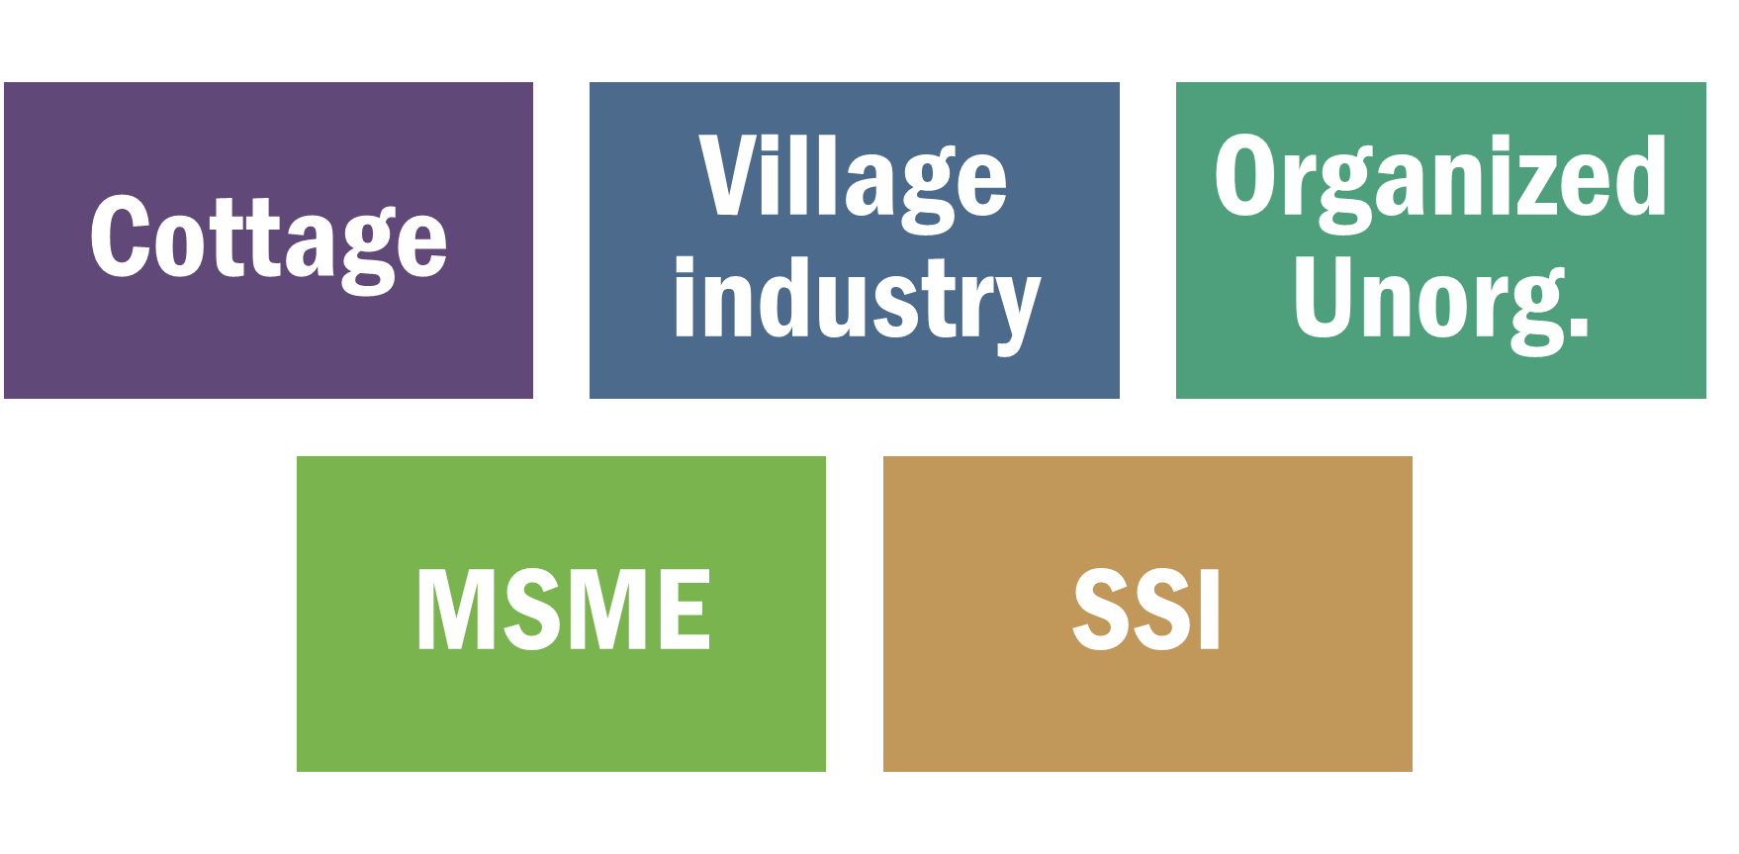
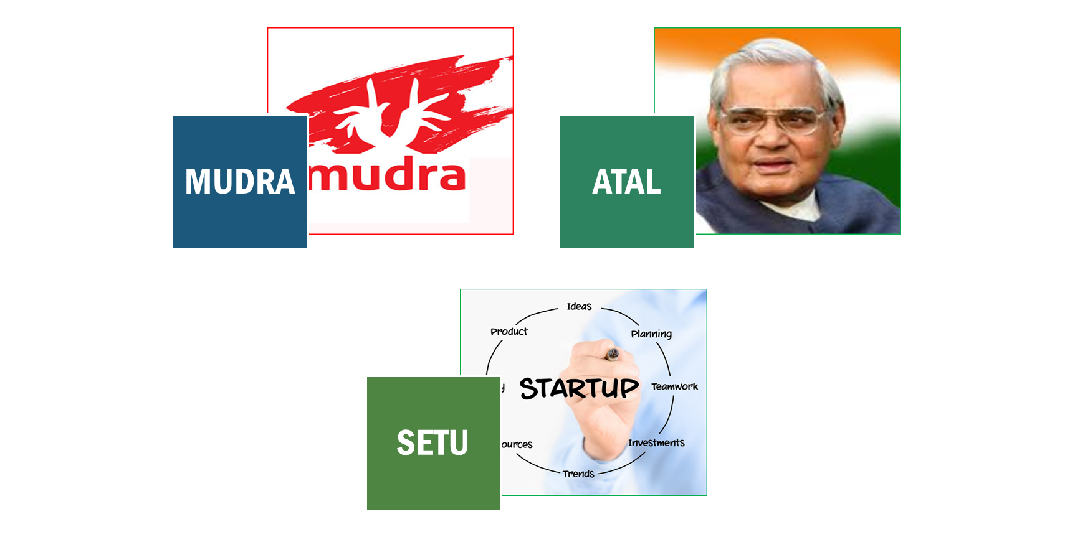

Slide 38
Legal framework for industries
Factory Labor reforms
Companies Act

Slide 39
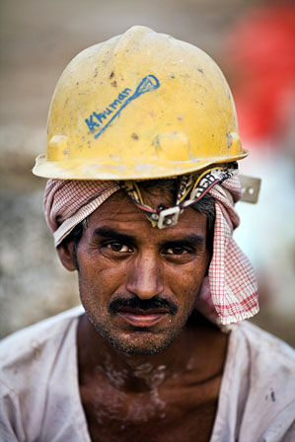
Labor reforms
WHY?
Labor laws: concurrent list
44 union, 150+ state laws
Inspector-bribe raj
Industrial dispute act ‘47
>100 workers, Government permission before laying off
Apprentices used as regular workers
Super-contractors: no EPF, SS

Slide 40
Labor reforms
Solution
Budget 2015: If 50 "regular workers": owner eligible for deduction. Earlier 100 required.
Two bills in LS (2014, Aug)
Factories Bill
Apprentice Bill

Slide 41

Factories Act
Laws
1948: Factories Act
2010: Narendra Jadhav Committee
2014: Amendment bill

Slide 42
Factories Act
Meaning
criteria | 1948 | 2014
power used | 10 workers | 20
power not used | 20 workers | 40
Higher ceiling 70% of units will escape. Heath safety compromised
Parliament standing Committee on Labor
Government to review the bill (2015-Jan-Feb)

Slide 43
Women Empowerment
Factories Bill
Women workers can do nightshift
Safety provision and home transport
Can work on moving / heavy machinery
Exempt: PH and mothers

Slide 44
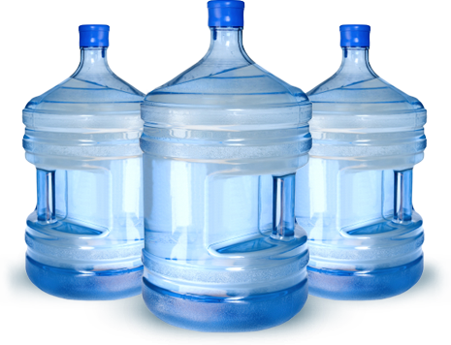
Workers Facilities
Factories Bill
Cool water irrespective of #workers
Spitton, sitting facilities=> compoundable offense.
Restroom, lunchroom >75 workers
Canteen: 200> workers
Self-certification
Union can also make rules. (earlier only states)

Slide 45

Overtime
Factories Bill
100 hours overtime per 3 months
Min. 90 days / year to get paid leaves.
Capacity: horsepower=> kilowatts
Can decide its own workweek.

Slide 46
Factory Reforms: 4 Benefits
Women Empowerment
Amnesties for Workers
Self Certification
No arrest on minor issues

Slide 47
Apprentice Act
laws
1961 outdated law
2014 bill
Age: 14 non-hz, 18 hazardous
non-engineering graduates and diplomas can enter
Common training by multiple companies
Test by National Council for Vocational Training (NCVT).

Slide 48
Legal framework for industries
Factory Labor reforms
Companies Act

Slide 49
Corporate governance: Meaning?
Way of directing the company
To protect stakeholders’ interest
To comply with legal-regulatory req.
Notes:
shareholder, employees, customers, suppliers, distributors

Slide 50
Corporate governance: Meaning?
Not mere technical compliance
Moral-ethical compliance
Absence: fraud, mismanagement
Notes:
shareholder, employees, customers, suppliers, distributors

Slide 51
Corporate governance in India
SEBI Norms:
Sep 2012: Adi Godrej
April 2014: Published
Effective 1st Oct. 2014
Companies Act
Original 1956
Aug 2013 (470 section)
…
Feb 2014: rules notified

Slide 52
Types of companies
Companies Act 2013
Public Ltd.
Capital 5 lakh
7-unlimited
Listed
Vodafone India.
Unlisted
Nokia India
Private ltd.
Capital 1 lakh
2-200
One person
Capital: 50 L
Turnover 2 cr.
Notes:
Total ~9 lakh companies
>90% private ltd.

Slide 53
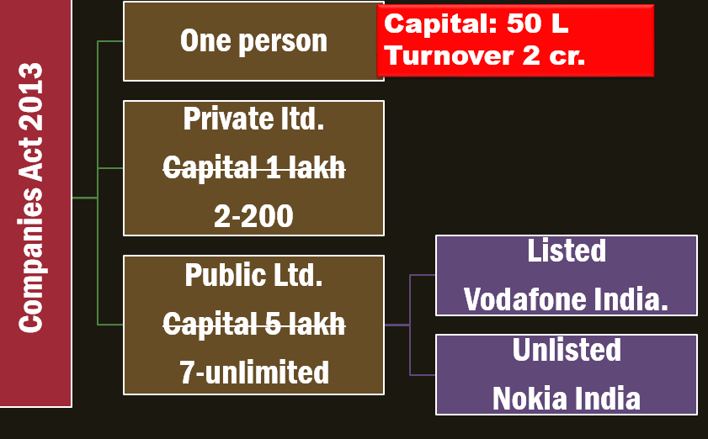
Companies act
types
Capital req. removed in Amendment bill 2014, for “ease of doing”
Anti-argument: shell companies, tax avoidance
>9 lakh companies in India, 90% of them Private limited companies.

Slide 54
Infosys
1981
Private ltd
1992
public. Ltd
1993
IPO launch
Notes:
One share sells for Rs.3200

Slide 55
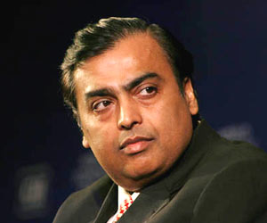
Holding vs. Subsidiary Companies
Reliance industries (Mukesh)
Network 18
CNN-IBN
CNBC
Forbes India Magazine
Colors
MTV
Reliance Retail
Reliance wellness
Delight Protein
Holding Company
Subsidiary
companies

Slide 56
Special Purpose Vehicle
Chandigarh Tricity Metro
Punjab State
Haryana State
Chandigarh UT (Union Min. Urban Dvlp )
MoU
Equity contribution
Reg. as Company
Profit sharing

Slide 57
Government owned = RTI applies to all
Government
PSU
Government Companies
Public Corporations
Dept. Undertakings
Not Government employees
Government employees

Slide 58
Dept.undertaking
Indian Railways, postal Department.
commercial activity such as engineering, manufacturing etc.
directly controlled, just like any other department
not under Companies act
Employees = Government servant. (service conduct rules apply)
Directly CAG + RTI

Slide 59
Government owned = RTI applies to all
Government
PSU
Government Companies
Public Corporations
Dept. Undertakings

Slide 60
PSU = RTI applies
Government companies
Public Corporation
ONGC, SAIL, Coal India ltd.
Registered in Companies Act
Government owns >50%
Majority BoD.
Employees Not public Govt.
CAG appointed pvt. auditors
LIC, Air India, IDBI, UTI
Act of Parliament / State Legislature
Wholly financed by Government
all BoD.
Employees Not public Govt.
Directly by CAG (some exception)

Slide 61
What is SBI then?
Presidency banks: Bengal, Bombay, Madras
Imperial Bank of India (1921)
SBI Act 1955- Government owned “Public” Corporation
SBI life insurance “COMPANY” ltd. JV between SBI + BNP Paribas
SBI General Insurance “COMPANY” ltd. JV between SBI +IAG (insurance Australia group
SBI Mutual funds “Private” limited Company

Slide 62
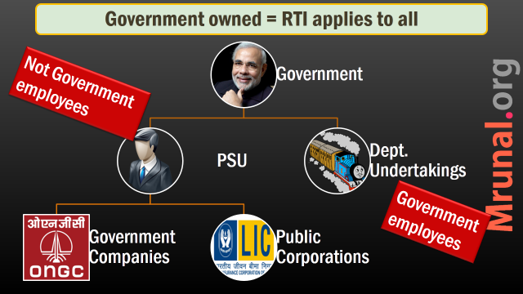
Types of companies
Companies Act
2013
Public Ltd.
7-unlimited
Listed
Vodafone India.
Unlisted
Nokia India
One person
Private ltd.
2-200

Slide 63
Companies Act 2013
BoD
CSR
4 Statutory Bodies
AGM
Audit Link

Slide 64

MD/CEO
Executives
Staff
Board of Directors
Chairman
IPO
SHARE-HOLDERS
Notes:
Kishor Biyani, Future group, Pantaloon

Slide 65

Board of directors
Companies Act
BoD
Chairman
Executive Director/Full-time
Nominated (Bank/Govt.)
Independent Director

Slide 66
Companies Act: Minimum Directors
Public Ltd.
7-unlimited
One person
Private ltd.
2-200
1
2
3-15
More by AGM
1 woman
1 Indian RESIDENT (Min.182 days)
Notes:
One person: maximum 20 companies.
12 months absent = vacate.

Slide 67
Board of directors
Companies Act
BoD
Chairman
Executive Director/Full-time
Nominated (Bank/Govt.)
Independent Director

Slide 68
Companies Act 2013: Independent director
Not a Promoter
Pecuniary interest…X (except salary as the “Director of the board”)
MD nominated…X
Employee…X

Slide 69

Companies Act: Independent Directors
Public Ltd.
7-unlimited
One person
Private ltd.
2-200
NA
NA
Min. 1/3 of board
1 guy Max. 7 companies
Terms: 5 years X 2
Cooling off 3 years
AGM Perfom. review
Notes:
ID: Separate meetings
One person max. 7 companies ID
Full-time director in 1 company => 3 companies' ID
Term: 2 x 5 years (Retrospective)
Performance report on ID
Atleast 1 woman director in the board

Slide 70
Companies Act 2013
BoD
CSR
4 Statutory Bodies
AGM
Audit Link

Slide 71
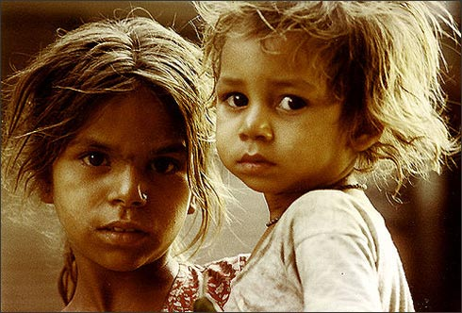
CSR 2% profit spending
Companies Act
Corporate social responsibility
Definition: companies integrate social and environmental concerns in their ops. (-UNIDO)
Last 3 years' avg. profit=> 2% CSR spend

Slide 72
CSR 2% profit spending
Companies Act
Applies to?
net profit of 50 million (Excluding Tax)
net worth of 5 billion (Asset-liability)
turnover of 10 billion (sales excluding costs)
Foreign branch…X
~6000 companies covered
2% profit = ~20k crore Rs in CSR

Slide 73

CSR Activities
Companies Act
BoD=>CSR Committee
Report to AGM
Serve directly / NGOs

Slide 74
Companies Act 2013
BoD
CSR
4 Statutory Bodies
AGM
Audit Link

Slide 75
4 statutory bodies
Tribunal
Reporting
Education
fraud

Slide 76

National Company Law Tribunal (NCLT)
Bodies
Judicial + technical members
Finish case in three months
Appeal: NCLAT
Present case by Self, Lawyer, CA, CS
Cases:
arbitration, compromise, M&A
Converting Public ltd. To private ltd.
Filing Class action suits (Satyam)

Slide 77

#2: National Financial Reporting Authority (NFRA)
Bodies
1 Chairman + 15 members
Accounting standards
Powers of civil court
Professional misconduct of CA/accountant=> debar
Appeal: NFRAA
ICAI unhappy (Chartered Accountants Act, 1949)
Notes:
SEBI=> SAT

Slide 78
4 statutory bodies
Tribunal
Reporting
Education
fraud

Slide 79

Investor and Education Protection Fund
body
Since 1956’s company act
Unclaimed Dividend, interest, principal
Under Corporate Affairs Ministry
Awareness, seminar, financial literacy
Participation from RBI, SEBI, experts

Slide 80
Investor and Education Protection Fund Authority
body
2013’s Act: Statutory authority
@Delhi HQ, Regional offices
Corp. Affairs Secretary = Chairman
Members:
RBI Executive directors
SEBI Executive directors
Legal experts etc.

Slide 81
4 statutory bodies
Tribunal
Reporting
Education
fraud

Slide 82

Serious Fraud Investigation Office (SFIO)
Bodies
Naresh Chandra report on Corp. governance
2003: under Corp. Ministry
Cases
Satyam
Reebok fraud
Sesa Goa invoice
Saradha Chitfund

Slide 83
Companies Act 2013: SFIO
Bodies
Statutory body
Not just document examination
Search seize arrest
CrPC power- investigator
Once SFIO gets case, other agencies can’t proceed.
State police, CBI -cooperate, provide documents, witnesses.

Slide 84
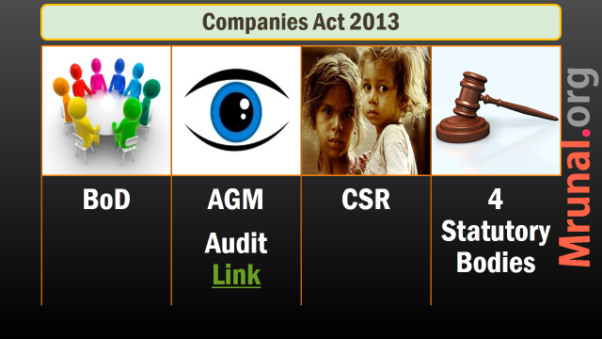
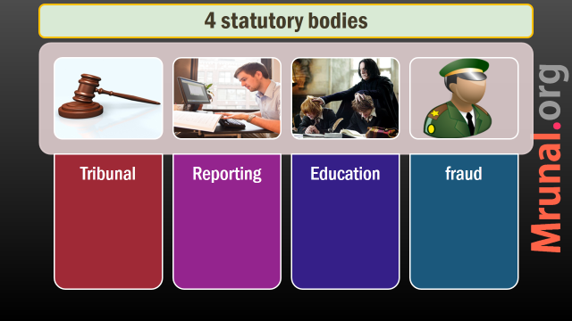

Slide 85

Companies Act 2013
Conclusion
Better corporate governance (ID)
Protecting small investors (statuary bodies)
business-friendly regulations, Self-regulation
Ease of doing business, Less government approval

Slide 86
Companies Act
bad
Paid up capital “ceiling” to be removed = shell companies, tax avoidance
private: 1 lakh
Public: 5 lakh
Women directors not appointed / kin of promoters appointed.

Slide 87
Companies Act
Bad
Smallest fraud need to be brought to AGM & Corporate ministries
Some companies begun converting public ltd. To private limited (e.g. TVS) to avoid transparency and reporting norms

Slide 88
Independent Directors
E-Voting
RPT- Related party transaction
Transparency
Salary Committee under ID
Audit Committee
Whistleblowers
SEBI Norms
Minority shareholders
Adi Godrej
1st October 2014
Notes:
Related party transaction
1st October 2014

Slide 89
